Slide 1
STATE OF PLAY
2018 SESSION
January 9th – March 9th

Slide 2
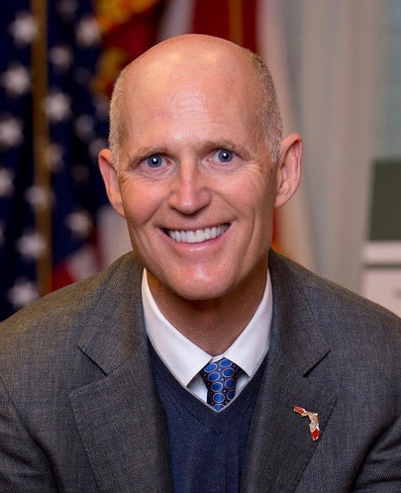
Players
Governor
Rick Scott

Slide 3
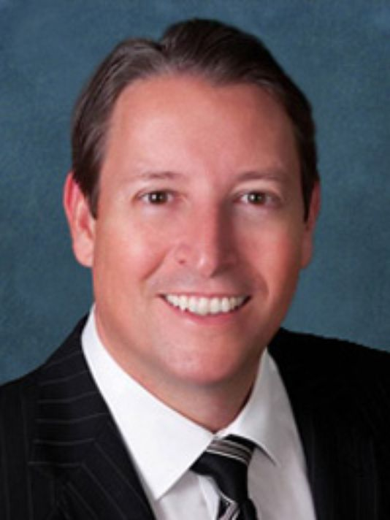
Players
Senator
Bill Galvano
R-21

Slide 4
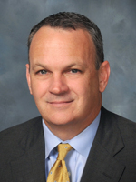
Players
Speaker
Richard Corcoran
R-37

Slide 5
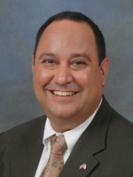
Players
Representative
Ray Rodrigues
R-76

Slide 6
Macro Issues
BUDGET: Scott has proposed an $87.4 billion spending plan for the fiscal year that starts July 1. The proposal includes politically popular ideas such as boosting education funding and providing tax cuts. But the proposal is only a starting point for lawmakers, who are expected to face a tight budget. A September analysis estimated a slim $52 million surplus for the coming year --- and that did not account for the state's costs from Hurricane Irma.

Slide 7
Macro Issues
ENVIRONMENT: Eyeing money from a 2014 constitutional amendment about land and water conservation, lawmakers will consider a series of proposals that could shield property from development and restore waterways. For example, Senate budget chief Rob Bradley, R-Fleming Island, has proposed spending $100 million a year on the Florida Forever program and wants to set aside $50 million a year for the restoration of the St. Johns River, its tributaries and the Keystone Heights lake region in North Florida.

Slide 8
Macro Issues
HIGHER EDUCATION: Senate President Joe Negron, R-Stuart, has made a top priority of revamping the higher-education system and will continue seeking changes during his final term. Senators are expected to quickly approve a bill that would make permanent an expansion of Bright Futures scholarships and take steps to further bolster need-based aid. Negron also wants changes such as holding universities to a four-year graduation standard in performance funding.

Slide 9
Macro Issues
HURRICANE IRMA: When Hurricane Irma smashed into Florida on Sept. 10, it reset priorities for the 2018 legislative session. Lawmakers are considering dozens of ideas for responding to Irma and preparing for future storms. For instance, they are looking at possibly providing financial help to the agriculture industry, which took at least a $2.5 billion hit in Irma. They also will grapple with Scott's push to require long-term care facilities to have generators and fuel to keep buildings cool when electricity goes out.

Slide 10
Macro Issues
K-12 EDUCATION: House Speaker Richard Corcoran, R-Land O' Lakes, has made clear he wants to continue expanding school-choice programs, which draw opposition from Democrats and many public-school officials. The House has started moving forward with a bill that would offer voucher-like scholarships to students who are bullied in public schools. Meanwhile, the House and Senate face a key budget disagreement on the use of increased property-tax revenues in funding public schools.

Slide 11
Macro Issues
TAX CUTS: Since taking office in 2011, Scott has made cutting taxes a hallmark of his administration. As he enters his final legislative session, Scott has proposed $180 million in tax and fee cuts. The proposal, however, does not include major changes in the tax system. Instead, it includes a 10-day sales tax “holiday” for back-to-school shoppers and reductions in motorist-related fees, including fees for obtaining and renewing driver's licenses.

Slide 12
Politics
10 Lawmakers have left office since last session
(Scandal, appointment to higher office, death)
4 have been replaced
Which leaves us with 154 out of 160

Slide 13
Politics
Latvala Sexual Harassment Allegations

Slide 14
Politics
Governor Rick Scott considering a run for U.S. Senate
&
Agriculture Commissioner, Adam Putnam, is running for Governor
&
House Speaker Richard Corcoran is close to launching a run for Governor (March)

Slide 15
SB 540 by Senator Dorothy Hukill
HB 831 by Representative Gruters
2+2 Program
Florida Community College System
Performance Funding
Direct Service Organizations
Enrollment Caps
Local Governance

Slide 16
2+2 Program
We welcome recommendations from the legislature that can further strengthen these partnerships.

Slide 17
Florida Community College System
Changing our system name back to the Florida Community College System does not reflect the evolution of the progressive system we have become.

Slide 18
Performance Funding
There are concerns about the metric that links college performance funds to the number of enrolled full-time in each of our colleges.

Slide 19
Direct Service Organizations
Mandating what colleges can spend on staff that raises funds will only be to the detriment of our students and programs.

Slide 20
Enrollment Caps
Baccalaureate programs exist to meet market demand, CAPS will only disrupt that! Our programs should be market-driven.

Slide 21
Local Governance
SB 540 seeks to change FCS governance from individual local boards to include a statewide board as well.

Slide 22
Thank you
Now go storm the Capitol!

